Slide 1

Data Exploration and Loops

Slide 2

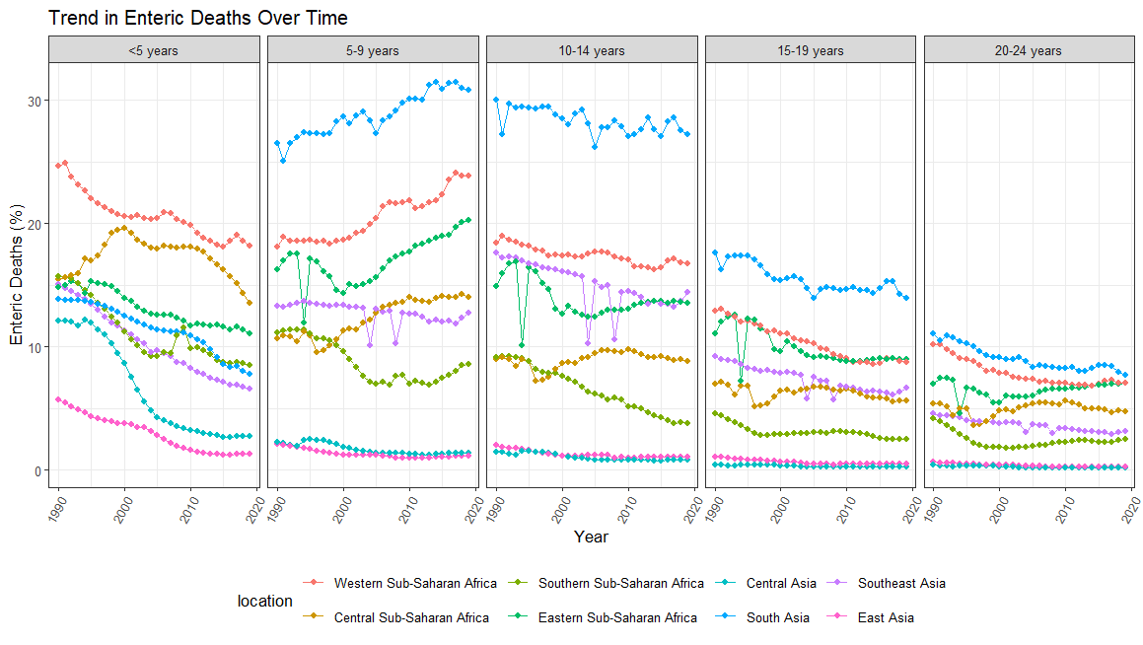
Recap
Notes:
GGPLOT, GGPUBR to visualize our data
On the y axis we have the for each location, the percentage of deaths in that region which are caused by enteric infections (i.e stomach infections- typhoid, cholera, rotavirus…)
X axis is the year- 1990-2020, and we have split our data by age groups, as well as region which is color coded
In the 5-9 year old group the percentage of deaths which are caused by enteric infections are rising… Now is that just because other causes are decreasing (%) makes it relative- or is the total number actually increasing…. We can get that data from the GBD site

Slide 3
Joining data
left_join(original_df, extra_df, by = c(“Joining var 1", "Joining var 2”))
Function | Objective
left_join() | Merge two datasets. Keep all observations from the original table
inner_join() | Merge two datasets. Excludes all unmatched rows
right_join() | Merge two datasets. Keep all observations from the extra table
full_join() | Merge two datasets. Keeps all observations
Original df, A, X
Extra df, B or Y
Notes:
Can join by one key/ID variable or more than one e.g AMPLE_ID and Visit
Left join filters out any extra data that we don't have in our orginal dataset, generally useful if you have collected more information/meta data on your samples, but your only intrested in getting information for this subset of participants you did an experiment on
Right join does the oposite, data that doesn’t have a match in your origina table is excluded and all data from the joining/extra table is kept
Inner_join excludes all unmatched rows
Full join keeps everything

Slide 4
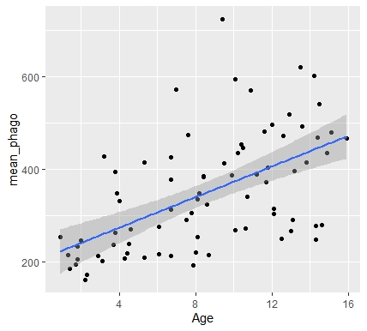
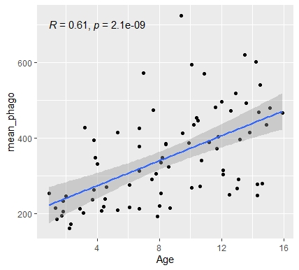
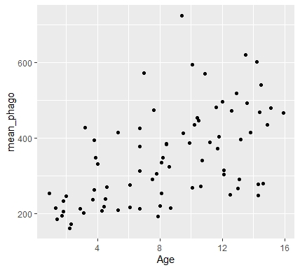
Correlation Plots
ggplot(dataframe, aes(x= Age, y= mean_phago)) + geom_point() + geom_smooth() + stat_cor(method = "pearson")
Plot a scatter graph of data using + geom_point()
Fit a regression line to our data using + geom_smooth(method = lm)
Add regression stats using + stat_cor(method = "pearson") – from ggpubr package
Notes:
Method=lm, SE around mean,
Highlight layer approach
More details at :http://www.sthda.com/english/wiki/ggplot2-scatter-plots-quick-start-guide-r-software-and-data-visualization

Slide 5

Explore in R

Slide 6
Controlling your code
So far, we have seen how R can be used to write code that includes functions within an order of operations to execute a task, e.g. plotting a graph, joining data, calculating the mean
For example:
Data_frame %>% ggplot(aes(x = year, y = deaths)) + geom_point()
Notes:
Could filter df first then plot

Slide 7
Controlling your code
advanced
But what if we have lots of data to sort and plot?
It’s not efficient to rewrite your code over and over again
Loops simplify your code, letting you write out your code just once!
The code then recycles through your data over and over again, repeating the functions we determine, until a condition is reached
For every variable (water scores, health care, education, etc) in our dataframe, plot the variable against death values
For every element (a, b, c) in our vector, print the element
Notes:
Instead of writing code for each individual plot
Or…
Element is the individual unit of our character vector
A loop is a programming instruction that repeats until a specific condition is reached.
The loop executes a code block again and again until no further action is required.
Each time the code block within the loop is executed is called an iteration.

Slide 8
For Loop Structure
For-Loops iterate (run through) individual elements in an object i.e vector, data fame or list
We specify what to run through, i.e the target object with ()
The loop statement { }, contains information about what function we would like to perform
for (element in vector) {
Perform function on that element
}
Cycling through the vector, or dataframe is referred to as an iteration
Notes:
Vectors are often a sequence of numbers or a sequence of column, specify in brackets
he vector provides the elements to repeat over, and its length determines how many times the loop runs

Slide 9
Basic for loops
For every element in character vector print each variable
for (element in char_vector) {
print(variable)
}
for (i in char_vector) {
print(i)
}
Shorten using i
Notes:
I like to write out what it is we want to achieve, and what you want repeated in plain english
We have a character vector, we want to print out each variable in the vector
I is used to store the variables, doesn’t have to be I could be n,m
I (every instance)
Numeric vector could be a sequence

Slide 10
Explore in R

Slide 11
Loops, inputs and outputs
Often instead of just using print we might want to store the results of loop to a new vector, dataframe, or plot
These are known as outputs
Outputs can be assigned within the loop function using <-
For the output to keep track of where we are in the loop, we subset our vector using [i]
R2 Values (output)
0.2
0.3
0.55
0.6
R Values (input)
0.4
0.3
0.55
0.6
Function = ^2
Notes:
Simple print not good enough
Need to store output data in a container

Slide 12
Explore in R

Slide 13
Conditional loops
For loops continue until the end of the sequence of items in the character/numeric vector or list is reached
We can however, add a conditions to the loop to determine whether or not to perform the loops function, or to stop the loop early
These conditions are based on logical operators such as ==, !=, &, |, <, >
https://www.youtube.com/watch?v=k0xgjUhEG3U

Slide 14
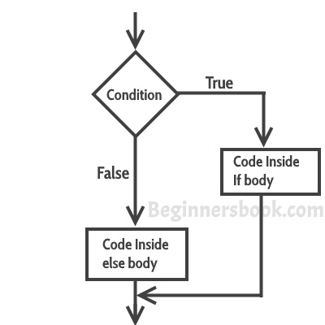
If Else Loops
If a condition is True, perform x function
If it’s False (Else), perform other function
These conditions can also be used to stop a loop early known as a break

